Slide 1
2:1-11

Slide 2
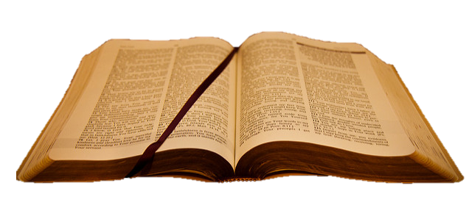
2:1-11
Moses
(c. 1400 BC)
John
(c. AD 100)
t h e W o r d o f G o d
1400 BC
1200 BC
1000 BC
800 BC
600 BC
400 BC
200 BC
BC/AD
66 books
Written over period of +- 1600 years
At least 40 authors
3 languages
3 continents
This Photo by Unknown Author is licensed under CC BY-SA
This Photo by Unknown Author is licensed under CC BY-SA

Slide 3
2:1-11

Slide 4
2:1-11
Methodist
Presbyterian
Synagogue
Baptist

Slide 5
2:1-11

Slide 6
2:1-11
2 Peter 2:1–11 ~ ¹ But there were also false prophets among the people, even as there will be false teachers among you, who will secretly bring in destructive heresies, even denying the Lord who bought them, and bring on themselves swift destruction. ² And many will follow their destructive ways, because of whom the way of truth will be blasphemed. ³ By covetousness they will exploit you with deceptive words; for a long time their judgment has not been idle, and their destruction does not slumber.
⁴ For if God did not spare the angels who sinned,

Slide 7
2:1-11
2 Peter 2:1–11 ~ but cast them down to hell and delivered them into chains of darkness, to be reserved for judgment; ⁵ and did not spare the ancient world, but saved Noah, one of eight people, a preacher of righteousness, bringing in the flood on the world of the ungodly; ⁶ and turning the cities of Sodom and Gomorrah into ashes, condemned them to destruction, making them an example to those who afterward would live ungodly; ⁷ and delivered righteous Lot, who was oppressed by the filthy conduct of the wicked ⁸ (for that righteous man, dwelling among them,

Slide 8
2:1-11
2 Peter 2:1–11 ~ tormented his righteous soul from day to day by seeing and hearing their lawless deeds) — ⁹ then the Lord knows how to deliver the godly out of temptations and to reserve the unjust under punishment for the day of judgment, ¹⁰ and especially those who walk according to the flesh in the lust of uncleanness and despise authority. They are presumptuous, self-willed. They are not afraid to speak evil of dignitaries, ¹¹ whereas angels, who are greater in power and might, do not bring a reviling accusation against them before the Lord.

Slide 9
2:1-11

Slide 10
2:1-11

Slide 11
2:1-11

Slide 12
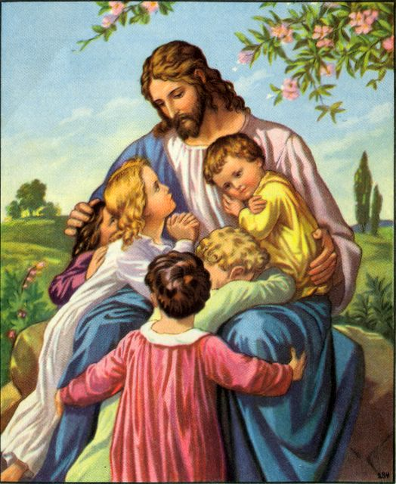
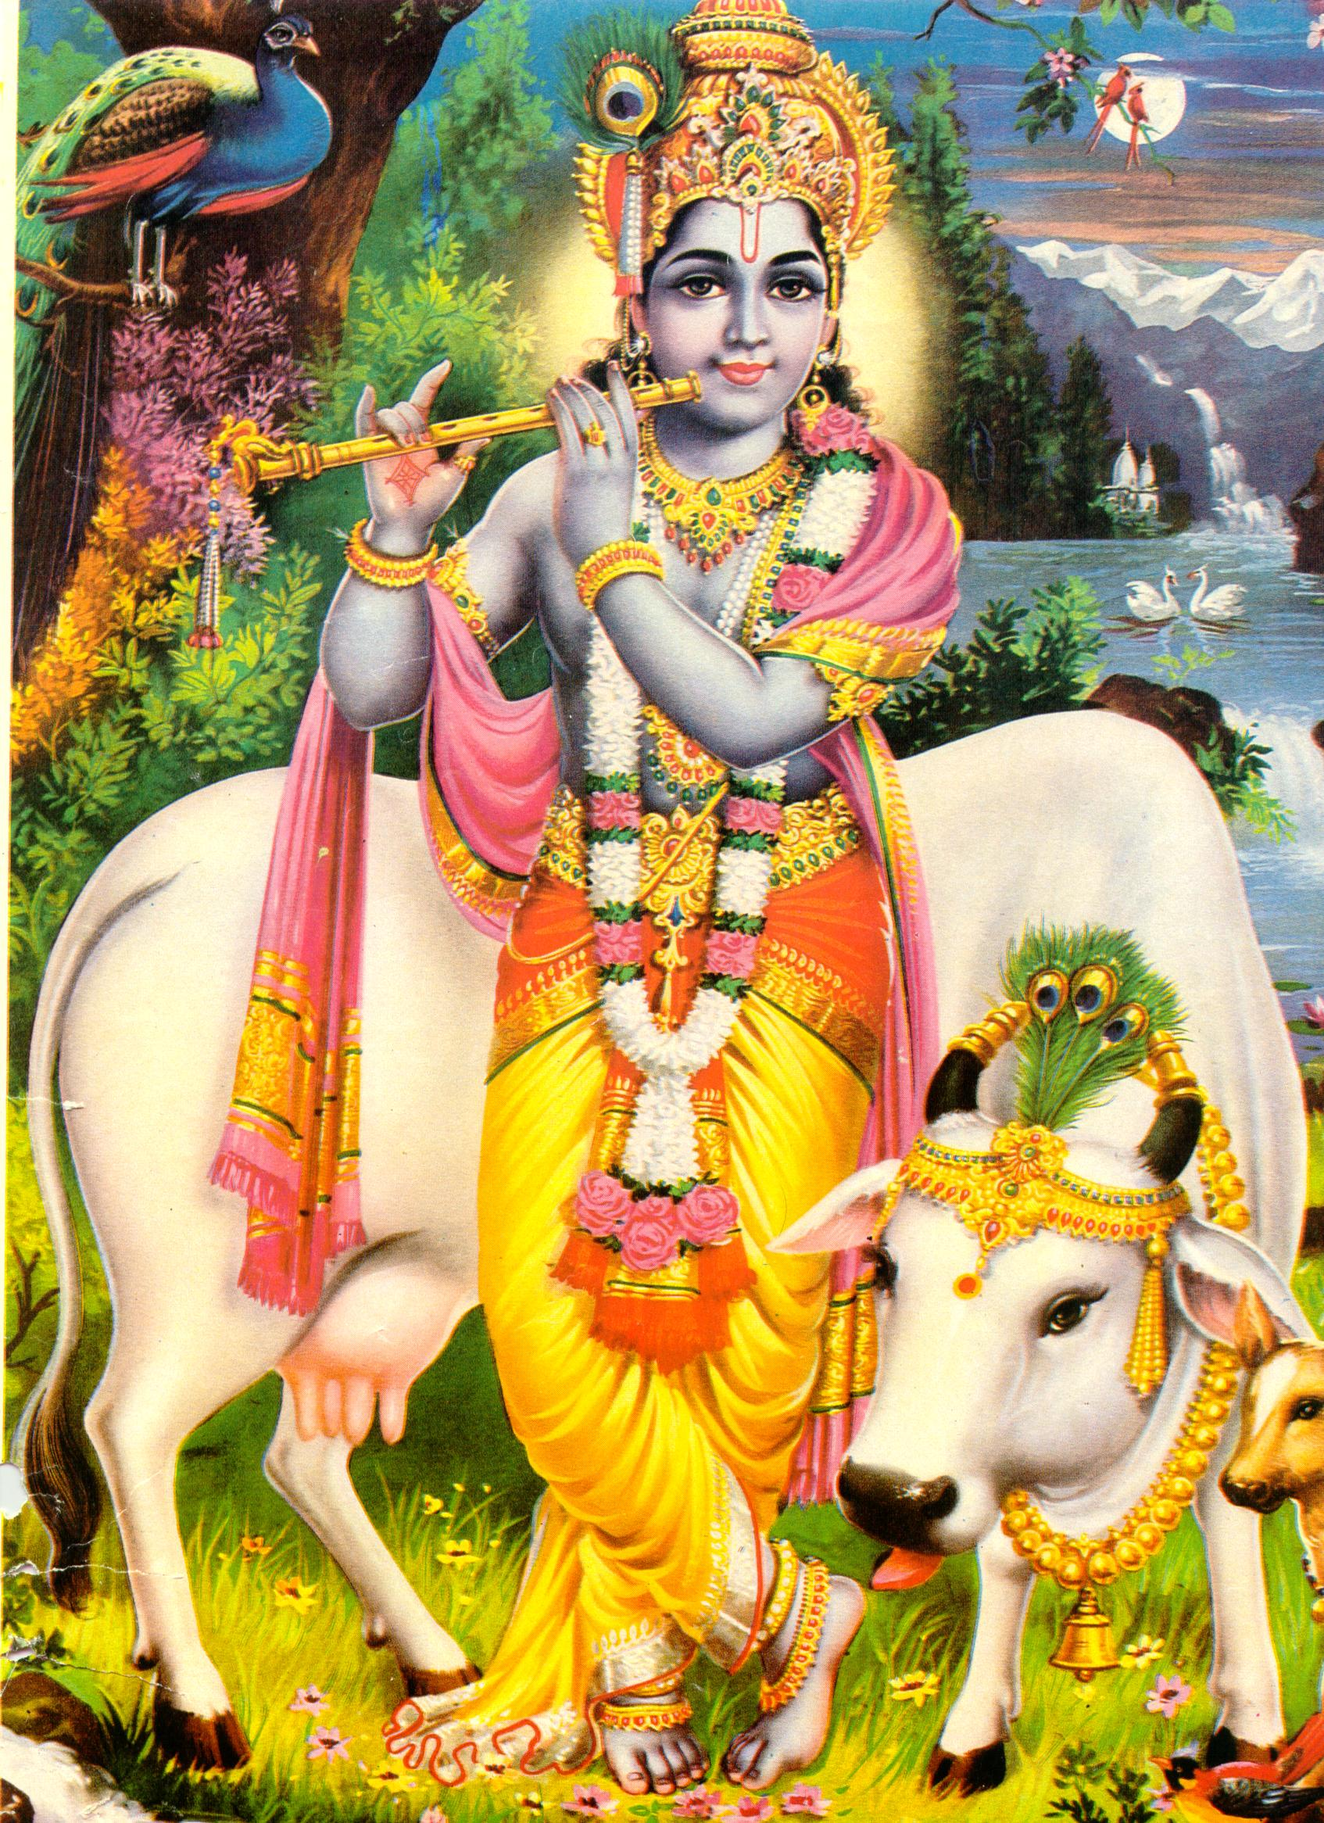
2:1-11
?
=

Slide 13
2:1-11
What are …
Deut. 13, 18;
Mic. 3;
Is. 9, 28;
Matt. 7;
Eze. 13, 14, 22;
1 & 2 Tim.;
Jer. 5, 6, 8, 20, 23, 27, 28, 29;
1 John 2, 4;
Zeph. 3;
2 Pet. 2
… talking about?

Slide 14
2:1-11

Slide 15
2:1-11
Luke 9:50 ~ But Jesus said to him, “Do not forbid him, for he who is not against us is on our side.”
Divisive sectarianism
Luke 11:23 ~ He who is not with Me is against Me, and he who does not gather with Me scatters.
Ambivalent neutrality
scatters ~ being neutral is worse than being anti

Slide 16
2:1-11
Divisive
Heresy hounds
Luke 9:50
Gullible Christians
Luke 11:23
Ambivalent
METRONOME
OF
CHRISTIANITY

Slide 17
2:1-11

Slide 18
2:1-11
What He did
Who He is
Sound Doctrine
False Doctrine
His physical resurrection

Slide 19
2:1-11
1) Does the teaching adhere to the major points of Christianity?
2) Does the teaching lead to Christ-likeness?
3) Does the teaching lead to a true worship of the true God?

Slide 20
2:1-11
Heresy ~ a : dissent or deviation from a dominant theory, opinion, or practice b : an opinion, doctrine, or practice contrary to the truth or to generally accepted beliefs or standards
Usually defines those outside of the “Big 3”
Aberrant ~ a : straying from the right or normal way b: deviating from the usual or natural type
Often applies to those within the “Lesser 3”

Slide 21
2:1-11

Slide 22
2:1-11
1 John 2:19 ~ ﻿They went out from us, but they were not of us; for ﻿ ﻿if they had been of us, they would have continued with us …
Matt. 7:21-23 ~ ²¹ Not everyone who says to Me, “Lord, Lord,” shall enter the kingdom of heaven, but he who does the will of My Father in heaven. ²² Many will say to Me in that day, “Lord, Lord, have we not prophesied in Your name, cast out demons in Your name, and done many wonders in Your name?” ²³ And then I will declare to them, “I never knew you; depart from Me, you who practice lawlessness!”

Slide 23
2:1-11

Slide 24
2:1-11
Jer. 23:16 ~ Thus says the Lord of hosts: “Do not listen to the words of the prophets who prophesy to you.
They make you worthless;
They speak a vision of their own heart,
Not from the mouth of the Lord.”
1 John 4:1 ~ Beloved, do not believe every spirit, but test the spirits, whether they are of God; because many false prophets have gone out into the world.

Slide 25
2:1-11

Slide 26
2:1-11
Acts 17:11 ~ These (the Bereans) were more fair-minded than those in Thessalonica, in that they received the word with all readiness, and searched the Scriptures daily to find out whether these things were so.

Slide 27
2:1-11

Slide 28
2:1-11
exploit ~ emporeuomai – emporium
Making merchandise through deception since 4004 BC
KJV ~ make merchandise
deceptive ~ plastos – plastic
All plastic
All the time

Slide 29
2:1-11

Slide 30
2:1-11
hell ~ 3 Greek words translated “hell” in New Testament
1. hadēs ~ (Hebrew, sheol) (11x) region of departed spirits of the lost (Matt. 11:23)
2. gèenna ~ (12x)place of eternal torment (derived from Valley of Himmon (literally, “doubtless a place of lamenting”) (Matt. 5:22)
Most likely the Lake of Fire (Rev. 19, 20)
3. tartarus ~ (1x) probably akin to abyssō (the Bottomless Pit)
Literally, the verb form ~ tartaroō

Slide 31
2:1-11

Slide 32
2:1-11
1 Cor. 6:9b-11 ~ ^{9b} Do not be deceived. Neither fornicators, nor idolaters, nor adulterers, nor homosexuals, nor sodomites, ¹⁰ nor thieves, nor covetous, nor drunkards, nor revilers, nor extortioners will inherit the kingdom of God.
¹¹ And such were some of you. But you were washed, but you were sanctified, but you were justified in the name of the Lord Jesus and by the Spirit of our God.

Slide 33
2:1-11

Slide 34
2:1-11
oppressed (v. 7) ~ kataponeō – to wear down

Slide 35
2:1-11

Slide 36
2:1-11
authority ~ kuriotēs – all authority

Slide 37
2:1-11

Slide 38
2:1-11
Phillips ~ Yet even angels, who are their superiors in strength and power, do not bring insulting criticisms of such things before the Lord.
Jude 1:9 ~ Yet Michael the archangel, in contending with the devil, … dared not bring against him a reviling accusation, but said, “The Lord rebuke you!”

Slide 39
2:1-11

